Slide 1
11b – Game Theory
This web quiz may appear as two pages on tablets and laptops.
I recommend that you view it as one page by clicking on the open book icon at the bottom of the page.

Slide 2
11b Game Theory
Must Know / Outcomes:
Use a profit-payoffs matrix (game theory) to explain the mutual interdependence of two rival firms and that the best outcome may not be individually rational
Use a profit-payoffs matrix (game theory) to explain why oligopolists might tempt to cheat on a collusive agreement.
Definitions:
Strategic behavior / strategic interaction
Prisoner’s Dilemma
Dominant Strategy
Self enforcing agreement
Individually rational
Nash Equilibrium

Slide 3
11b Oligopoly - Game Theory
Definitions:
Strategic behavior / strategic interaction: Decision-making when the outcome also depends on the actions of others
Prisoner’s Dilemma: The best choice for both players is not the equilibrium (rational) outcome
Dominant Strategy: a choice for a player that maximizes their satisfaction no matter what their rivals are doing
Self enforcing agreement: Occurs when both players cannot improve their situation by changing their choice
Individually rational: choice that increases your satisfaction
Nash Equilibrium: The outcome (equilibrium) of game theory when each player is individually rational (their dominant strategy) given what all other players are doing

Slide 5
1. Strategic behavior means:
outcome depends not just on what you do, but what your competitor does
neither can improve their situation by changing their minds
a choice for a player that maximizes her satisfaction no matter what her rivals are doing

Slide 6
1. Strategic behavior means:
outcome depends not just on what you do, but what your competitor does
neither can improve their situation by changing their minds
a choice for a player that maximizes her satisfaction no matter what her rivals are doing

Slide 7
2. Dominant Strategy means:
outcome depends not just on what you do, but what your competitor does
neither can improve their situation by changing their minds
a choice for a player that maximizes her satisfaction no matter what her rivals are doing

Slide 8
2. Dominant Strategy means:
outcome depends not just on what you do, but what your competitor does
neither can improve their situation by changing their minds
a choice for a player that maximizes her satisfaction no matter what her rivals are doing

Slide 9
3. Self enforcing agreement means:
outcome depends not just on what you do, but what your competitor does
neither can improve their situation by changing their minds
a choice for a player that maximizes her satisfaction no matter what her rivals are doing

Slide 10
3. Self enforcing agreement means:
outcome depends not just on what you do, but what your competitor does
neither can improve their situation by changing their minds
a choice for a player that maximizes her satisfaction no matter what her rivals are doing

Slide 11
4. What is Nash Equilibrium?
outcome depends not just on what you do, but what your competitor does
neither can improve their situation by changing their minds
the outcome when each player is doing the best they can given what all other players are doing
a choice for a player that maximizes her satisfaction no matter what her rivals are doing

Slide 12
4. What is Nash Equilibrium?
outcome depends not just on what you do, but what your competitor does
neither can improve their situation by changing their minds
the outcome when each player is doing the best they can given what all other players are doing
a choice for a player that maximizes her satisfaction no matter what her rivals are doing

Slide 13
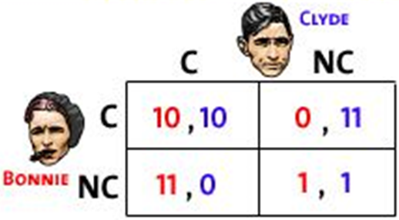
Nash Equilibrium The outcome when each player is doing the best they can given what all other players are doing
PRISONER’S DILEMMA:
The Nash equilibrium is both
of them confessing.
The best option for both of them
would be to not confess.

Slide 14
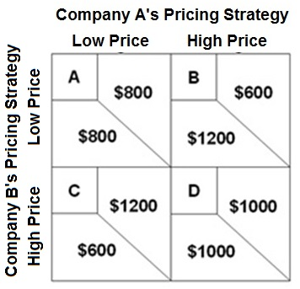
For the following questions refer to this game theory matrix where the numerical data show the profits resulting from alternative combinations of advertising strategies for Ajax and Acme. YP 63

Slide 15
5. If company A does a high price then the dominant strategy for B will be: YP 63
Low Price
High Price
Neither

Slide 16
5. If company A does a high price then the dominant strategy for B will be: YP 63
Low Price
High Price
Neither

Slide 17
6. The dominant strategy will be: YP 63
High for A; Low for B
Low for A; High for B
Low Price for both
High Price for both

Slide 18
6. The dominant strategy will be: YP 63
High for A; Low for B
Low for A; High for B
Low Price for both
High Price for both

Slide 19
7. The Nash equilibrium will be cell: (YP 63)
A
B
C
D

Slide 20
7. The Nash equilibrium will be cell: (YP 63)
A
B
C
D

Slide 21
DEFINITION: Nash Equilibrium The outcome (equilibrium) of game theory when each player is individually rational (their dominant strategy) given what all other players are doing. A self-enforcing agreement. No one can gain by changing strategies if nobody else does.

Slide 22
Nash Equilibrium is cell A.
No one can gain by changing strategies if nobody else does.

Slide 23
8. Without collusion, the outcome of the game is cell: (YP 63)
A
B
C
D

Slide 24
8. Without collusion, the outcome of the game is cell: (YP 63)
A
B
C
D

Slide 25
9. With collusion and no cheating, the outcome of the game is cell: (YP 63)
A
B
C
D

Slide 26
9. With collusion and no cheating, the outcome of the game is cell: (YP 63)
A
B
C
D

Slide 27
10. If A and B agree to a high price policy through collusion, the temptation to cheat on that agreement is demonstrated by the fact that: (YP 63)
Company A can increase profits by charging a lower price
Company A can increase profits by charging a higher price
Profits increase if both charge a lower price

Slide 28
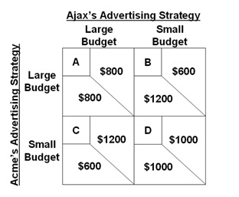
10. If A and B agree to a high price policy through collusion, the temptation to cheat on that agreement is demonstrated by the fact that: (YP 63)
Company A can increase profits by charging a lower price
Company A can increase profits by charging a higher price
Profits increase if both charge a lower price

