Slide 1
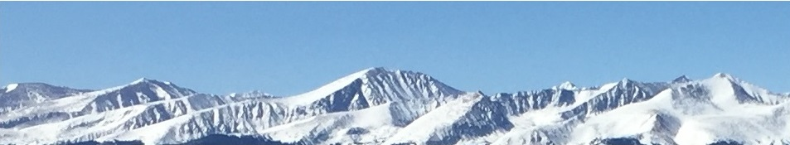
ARE BUSINESSES EFFICIENT?
11a – Monopolistic Competition
This web quiz may appear as two pages on tablets and laptops.
I recommend that you view it as one page by clicking on the open book icon at the bottom of the page.

Slide 2

ARE BUSINESSES EFFICIENT?
11a – Monopolistic Competition
1. Characteristics and Examples
2. Nature of the Demand Curve
3. Short Run Equilibrium
4. Long Run Equilibrium and Efficiency
5. Other Issues
  Concentration Ratio and Herfindahl Index
  Product Differentiation
  Excess Capacity

Slide 3
Review Lesson 10b
Monopoly: Long Run Equilibrium
YP 36 Draw the graphs for a monopoly in Long Run Equilibrium show the:
  Profit maximizing Q
  Allocatively efficient Q
  Productively efficient Q
YP 38 Draw the graphs for a Regulated Natural Monopoly in Long Run Equilibrium show the:
  Profit maximizing Q if it is not regulated
  Productively efficient Q
  Allocatively efficient Q
  Price and quantity if the monopoly if regulated using the “fair return” (AC) approach
  Price and quantity if the monopoly if regulated to achieve allocative efficiency
YP 39 and 42 #10-13 Price Discrimination
10b – Monopoly: Long-Run Equilibrium

Slide 4
OUTCOMES – Monopolistic Competition:
List the characteristics of monopolistic competition.
How many is “many”? (Concentration Ratio and Herfindahl Index)
Explain how product differentiation occurs in similar products.
Determine the profit maximizing price and output level for a monopolistic competitor in the short run when given cost and demand data.
Explain why a monopolistic competitor will realize only normal profit in the long run.
Draw the short run equilibrium graphs for a monopolistically competitive firm that (a) maximizes profit, (b) minimizes loss, and (c) shuts down
Understand the adjustment process from the short run to the long run and the role of barriers to entry (why do monopolistically competitive firms earn zero economic profits in the long run?)
Draw the long run equilibrium graph for a monopolistically competitive firm and indicate the profit maximizing quantity, the allocatively efficient quantity, and the productively efficient quantity.
Why does a monopolistically competitive firm earn zero economic profits (normal profits) in the long run?
Identify the reasons for excess capacity in monopolistic competition.
Explain how product differentiation may offset these inefficiencies.
11a – Monopolistic Competition

Slide 5
KEY TERMS:
monopolistic competition,
product differentiation,
collusion,
nonprice competition,
four-firm concentration ratio,
Herfindahl index,
normal profit,
excess capacity,
11a – Monopolistic Competition

Slide 6
Lesson 11a – Introduction
ARE BUSINESSES EFFICIENT?
Competitive firms are efficient and monopolies are inefficient, but there are few if any purely competitive markets or purely monopolistic markets (monopolies). So what happens in the real world? Are businesses efficient?
We will learn that both monopolistically competitive firms and oligopolies are inefficient but not to the same degree. Monopolistically competitive firms are only slightly inefficient and they do provide society some additional benefits, but oligopolies can be very inefficient and are closely watched by the government.
11a – Monopolistic Competition

Slide 7
Lesson 11a – Something Interesting
WHY ARE WE STUDYING THIS?
Why are there so many different kinds of hamburgers?
  Wikipedia has a list of 30 different types of hamburgers [https://en.wikipedia.org/wiki/List_of_hamburgers]. Why are there so many? Why do different restaurants continue to invent their own "new" hamburger?
  ANSWER: In this lesson you will learn that firms gain market power through product differentiation - making their product a little different from their competitors. This allows them to charge a higher price and increase their profits. BUT, other restaurants can always copy the new hamburger recipe stealing away those profits. Welcome to Monopolistic Competition: part "monopoly" because of product differentiation and part "pure competition" because of low barriers to entry.
11a – Monopolistic Competition

Slide 8
English Lesson (1)
A word that modifies (describes) a noun is called a what? (like BIG ball, FUN skiing, and RED sled)
  There are four product market models used to classify the 1000s of industries.
  To distinguish between the four models we must use an adjective to modify the noun “industry”.
What would the adjective be if we wanted to identify an industry that fits the PURE COMPETITION model?
  It would be a ___________ industry.
11a – Monopolistic Competition

Slide 9
English Lesson (2)
What would the adjective be if we wanted to identify an industry that fits the ____________ model?
PURE COMPETITION: COMPETITIVE industry.
MONOPOLY: ___________ industry.
OLIGOPOLY: ___________ industry.
11a – Monopolistic Competition

Slide 10
English Lesson (2)
What would the adjective be if we wanted to identify an industry that fits the ____________ model?
PURE COMPETITION: COMPETITIVE industry.
MONOPOLY: MONOPOLISTIC industry.
OLIGOPOLY: OLIGOPOLISTIC industry.
MONOPOLISTIC COMPETITION: ____????___ industry.
11a – Monopolistic Competition

Slide 11
English Lesson (2)
What would the adjective be if we wanted to identify an industry that fits the MONOPOLISTIC COMPETITION model?
It would be a:
________________ _______________ industry.
(adverb) (adjective)
11a – Monopolistic Competition

Slide 12
English Lesson (2)
What would the adjective be if we wanted to identify an industry that fits the MONOPOLISTIC COMPETITION model?
It would be a:
MONOPOLISTICALLY COMPETITIVE industry.
(adverb) (adjective)
You must say “monopolistically competitive” if you are talking about monopolistic competition. If you just say “monopolistic”, then you are talking about a monopoly.
11a – Monopolistic Competition

Slide 13
ARE BUSINESSES EFFICIENT?
11a – Monopolistic Competition
1. Characteristics and Examples
2. Nature of the Demand Curve
3. Short Run Equilibrium
4. Long Run Equilibrium and Efficiency
5. Other Issues
  Concentration Ratio and Herfindahl Index
  Product Differentiation
  Excess Capacity

Slide 14
1. Which is not a characteristic of monopolistic competition?
Many firms
Standardized product
Some control over price (market power)
Low barriers to entry
A lot of non-price competition

Slide 15
1. Which is not a characteristic of monopolistic competition?
Many firms
Standardized product
Some control over price (market power)
Low barriers to entry
A lot of non-price competition

Slide 16
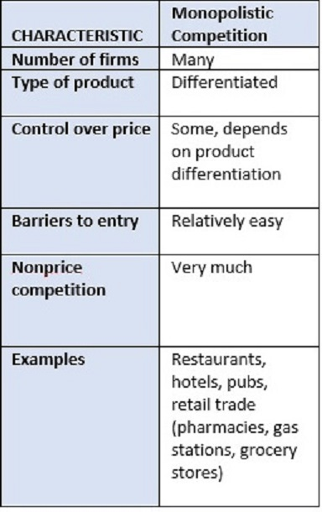

Slide 17
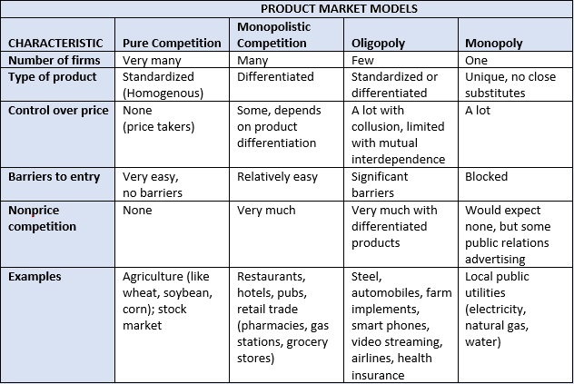

Slide 18
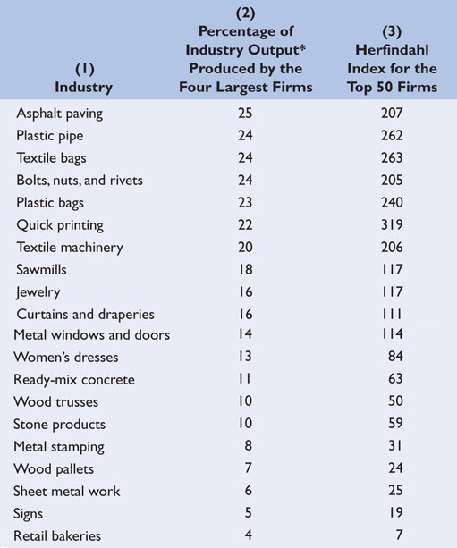
How many
is “many”?
So many that:
  - Collusion is
  not possible
  - No Mutual
  Interdependence
  - Low Concentration
  Ratio
  - Low Herfindahl
  Index

Slide 19
Concentration Ratio - low
The percentage of the total sales of an industry made by the four
(or some other number) largest sellers in the industry.
Herfindahl Index - low
The sum of the squared percentage market shares of the individual firms
SUM % market shares squared:
  If monopoly = 100 squared = 100 x 100 = 10,000
  If 4 firms with 25% each = 25 squared + 25 squared + 25 squared + 25 squared = 2500
  if 100 firms with 1% each = 1 squared + 1 squared + . . . . . = 100
11a – Monopolistic Competition

Slide 20
What if there are only four companies in the industry with the following market shares?
  1%, 1%, 1%, 97%
    Concentration Ratio = 100%
    Herfindahl index = 9412
  25%, 25%, 25%, 25%
    Concentration Ratio = 100%
    Herfindahl index = 2500
This is why the Herfindahl index may be better than the concentration ratio.
11a – Monopolistic Competition

Slide 21
2. Which of the following is probably not a method of product differentiation?
Product packaging
Large number of sellers
Brand name loyalty
Advertising

Slide 22
2. Which of the following is probably not a method of product differentiation?
Product packaging
Large number of sellers
Brand name loyalty
Advertising

Slide 24
3. Product differentiation matters for monopolistically competitive firms because :
It makes their demand downward sloping
Makes their demand perfectly elastic
It forces them to accept the market price for their product
It makes the demand for their products more elastic

Slide 25
3. Product differentiation matters for monopolistically competitive firms because :
It makes their demand downward sloping
Makes their demand perfectly elastic
It forces them to accept the market price for their product
It makes the demand for their products more elastic

Slide 26
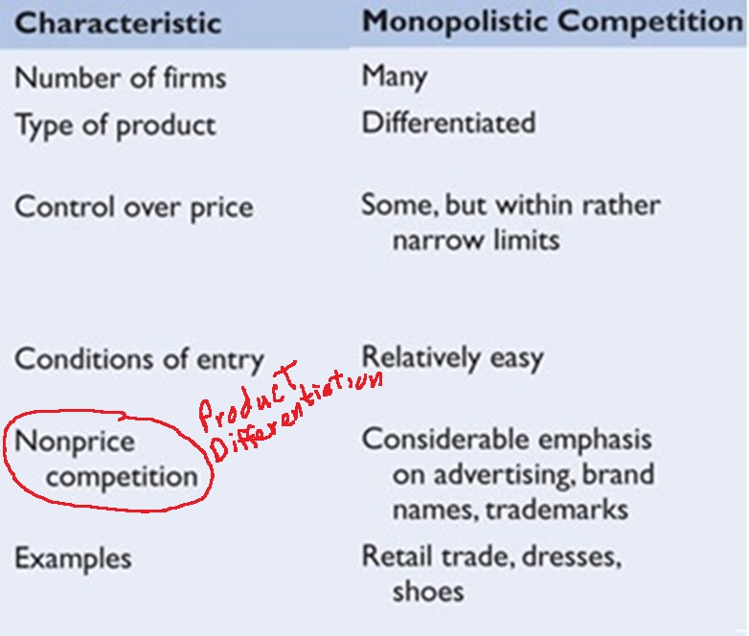

Slide 27
Product Differentiation
1. Definition:
  A strategy in which one firm’s product is distinguished from competing products by means of its design, related services, quality, location, or other attributes (except price).
2. Also called non-price competition:
  Firms can compete by saying “our product is cheaper” (price competition)
  Or, firms can compete by saying our product is better, bigger, faster, etc.,
  (this is NON-PRICE COMPETITION)
3. How?
  a) different product quality
  b) different services
  c) different location
  d) different brand names and packaging
4. Effect: gives firms some control over price (downward sloping demand curve)
5. Cost of product differentiation: need to advertise
11a – Monopolistic Competition

Slide 28
4. Which of the following is an example of a monopolistically competitive industry?
Wheat farming
Cable TV
Automobiles
Restaurants

Slide 29
4. Which of the following is an example of a monopolistically competitive industry?
Wheat farming
Cable TV
Automobiles
Restaurants

Slide 30
A monopolistically competitive industry combines elements of both competition and monopoly.
  The monopoly element results from:
  Product differentiation
  The competitive element results from:
  Low entry barriers
11a – Monopolistic Competition

Slide 31
ARE BUSINESSES EFFICIENT?
11a – Monopolistic Competition
1. Characteristics and Examples
2. Nature of the Demand Curve
3. Short Run Equilibrium
4. Long Run Equilibrium and Efficiency
5. Other Issues
  Concentration Ratio and Herfindahl Index
  Product Differentiation
  Excess Capacity

Slide 32
5. Which is true for the demand curve for a monopolistically competitive industry?
Horizontal and perfectly elastic
Downward sloping and perfectly inelastic
Downward sloping and inelastic
Downward sloping and elastic

Slide 33
5. Which is true for the demand curve for a monopolistically competitive industry?
Horizontal and perfectly elastic
Downward sloping and perfectly inelastic
Downward sloping and inelastic
Downward sloping and elastic

Slide 34
ARE BUSINESSES EFFICIENT?
11a – Monopolistic Competition
1. Characteristics and Examples
2. Nature of the Demand Curve
3. Short Run Equilibrium
4. Long Run Equilibrium and Efficiency
5. Other Issues
  Concentration Ratio and Herfindahl Index
  Product Differentiation
  Excess Capacity

Slide 35
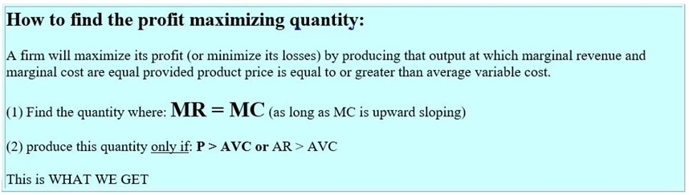
11a – Monopolistic Competition
YP 48

Slide 36
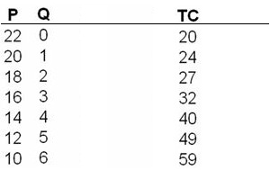
6. What is the profit-maximizing output and price for this monopolistically competitive firm?
YP 47 #9
P = 12; Q = 5
P = 14; Q = 4
P = 16; Q = 3
P = 18; Q = 2

Slide 37
6. What is the profit-maximizing output and price for this monopolistically competitive firm?
YP 47 #9
P = 12; Q = 5
P = 14; Q = 4
P = 16; Q = 3
P = 18; Q = 2

Slide 38
7. What are the maximum profits possible in the short run?
YP 47 #10
$ 16
$ 40
$ 56
$ 59

Slide 39
7. What are the maximum profits possible in the short run?
YP 47 #10
$ 16
$ 40
$ 56
$ 59

Slide 40
8. What are the short run profits?
YP 45 #3
Loss of $320
Profit of $480
Profit of $280
Profit of $600

Slide 41
8. What are the short run profits?
YP 45 #3
Loss of $320
Profit of $480
Profit of $280
Profit of $600

Slide 42
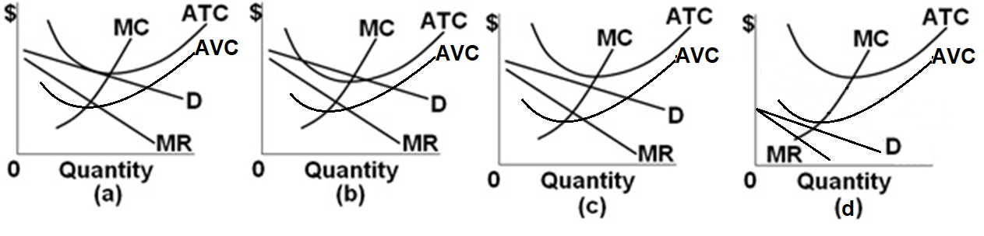
9. Monopolistic competition. Which graph shows a short run loss? YP 46 #5
(a)
(b)
(c)
(d)

Slide 43
9. Monopolistic competition. Which graph shows a short run loss? YP 46 #5
(a)
(b)
(c)
(d)

Slide 44
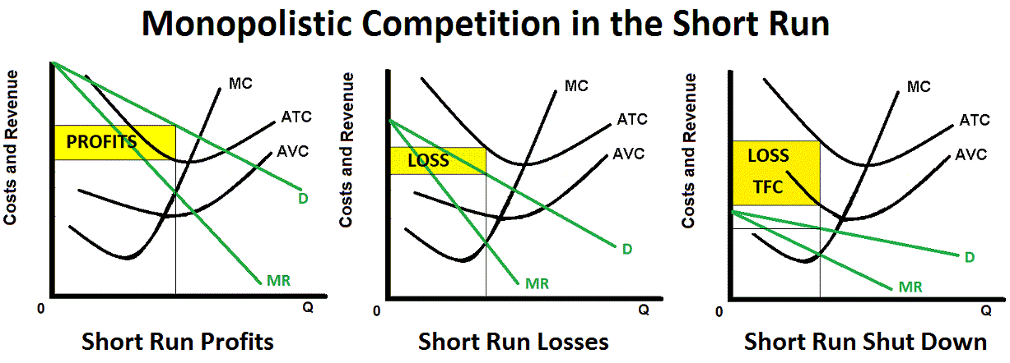
The short run graphs look a lot like the monopoly short run graphs with a more elastic demand curve.
(Why more elastic?)
Be able to Define, Draw, and Describe the shape of these graphs.
11a – Monopolistic Competition

Slide 45
ARE BUSINESSES EFFICIENT?
11a – Monopolistic Competition
1. Characteristics and Examples
2. Nature of the Demand Curve
3. Short Run Equilibrium
4. Long Run Equilibrium and Efficiency
5. Other Issues
  Concentration Ratio and Herfindahl Index
  Product Differentiation
  Excess Capacity

Slide 46
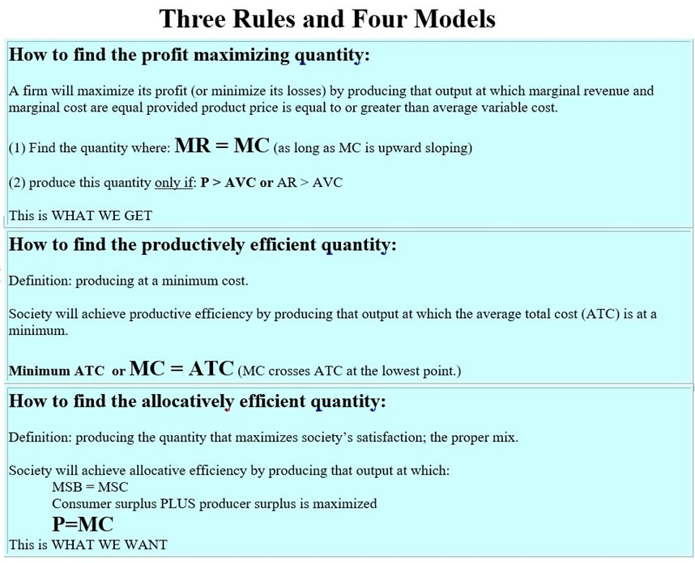
YP
48

Slide 47
Why are Barriers Important?
Barriers to entry allow firms to earn long run profits and to be inefficient.
Pure Comp. = no barriers = no long run profits
Monopoly = entry blocked = long run profits
Monop. Comp. = few barriers = no long run profits
Oligopoly = high barriers = long run profits
10b – Monopoly: Long-Run Equilibrium

Slide 48
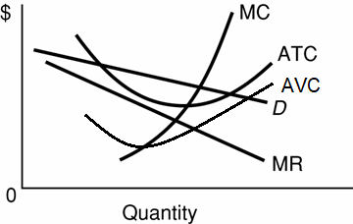
10. If this is the SR equilibrium, then what will happen in the LR for monopolistically competitive firms:
(YP 49)
Entry is blocked so there will be no change
Firms will enter and demand for the remaining firms will decrease
Firms will leave and supply will increase
Firms will enter and demand for the remaining firms will increase

Slide 49
10. If this is the SR equilibrium, then what will happen in the LR for monopolistically competitive firms:
(YP 49)
Entry is blocked so there will be no change
Firms will enter and demand for the remaining firms will decrease
Firms will leave and supply will increase
Firms will enter and demand for the remaining firms will increase

Slide 50
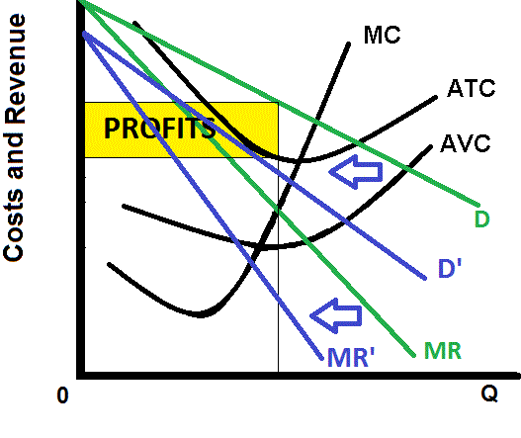
If there are short run profits in a monopolistically competitive industry, new firms will enter because of low barriers to entry.
This entry of new firms will cause the demand for existing firms to decrease, causing the price to decrease reducing the profits.
YP 49
11a – Monopolistic Competition

Slide 51
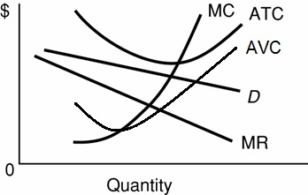
11. If this is the SR equilibrium, then what will happen in the LR for monopolistically competitive firms:
(YP 49)
Entry is blocked so there will be no change
Firms will enter and demand for the remaining firms will decrease
Firms will leave and supply will increase
Firms will leave and demand for the remaining firms will increase

Slide 52
11. If this is the SR equilibrium, then what will happen in the LR for monopolistically competitive firms:
(YP 49)
Entry is blocked so there will be no change
Firms will enter and demand for the remaining firms will decrease
Firms will leave and supply will increase
Firms will leave and demand for the remaining firms will increase

Slide 53
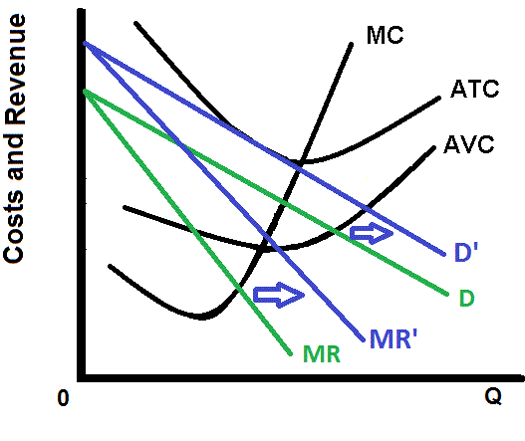
If there are short run losses in a monopolistically competitive industry (see the green D and MR curves) firms will the industry.
This exit of firms will cause the demand for existing firms to increase (see the blue D and MR curves) causing the price to increase.
YP 49
11a – Monopolistic Competition

Slide 54
12. A monopolistically competitive firm in long run equilibrium will earn:
Economic profits
Economic losses
Zero economic profits

Slide 55
12. A monopolistically competitive firm in long run equilibrium will earn:
Economic profits
Economic losses
Zero economic profits (called normal profits)

Slide 56
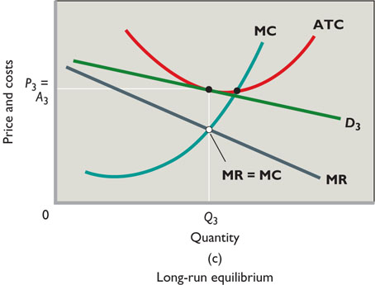
Monopolistic Competition
Long Run Equilibrium:
RESULT: Normal Profits only
But there are complications:
Some firms may achieve
a measure of differentiation that is
not easily duplicated by rivals
(brand names, location, etc.)
and can realize economic profits in the long run.
(2) There is some restriction to entry, such as financial barriers that exist
for new small businesses, so economic profits may persist for existing
firms.
(3) Long-run below-normal profits may persist, because producers like to
maintain their way of life as entrepreneurs despite the low economic
returns.

Slide 57
Why are Barriers Important?
Barriers to entry allow firms to earn long run profits and to be inefficient.
Pure Comp. = no barriers = no long run profits
Monopoly = entry blocked = long run profits
Monop. Comp. = few barriers = no long run profits
Oligopoly = high barriers = long run profits
10b – Monopoly: Long-Run Equilibrium

Slide 58
Monopolistic Competition
Long Run Equilibrium:
RESULT: Normal Profits only
But there are complications:
Some firms may achieve
a measure of differentiation that is
not easily duplicated by rivals
(brand names, location, etc.)
and can realize economic profits in the long run.
(2) There is some restriction to entry, such as financial barriers that exist
for new small businesses, so economic profits may persist for existing
firms.
(3) Long-run below-normal profits may persist, because producers like to
maintain their way of life as entrepreneurs despite the low economic
returns.

Slide 59
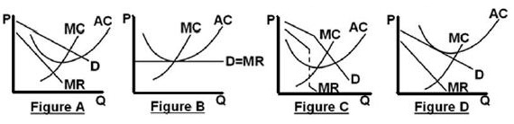
13. Which graph shows a monopolistically competitive firm in long run equilibrium?
A
B
C
D

Slide 60
13. Which graph shows a monopolistically competitive firm in long run equilibrium?
A
B
C
D

Slide 61
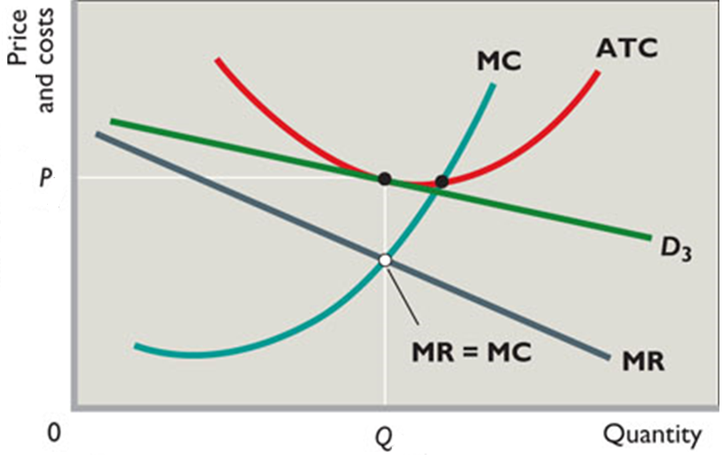
11a – Monopolistic Competition
YP 50
Long Run Equilibrium Graph

Slide 62
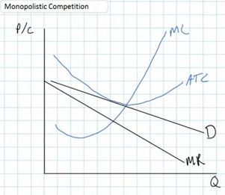
YP 50

Slide 63
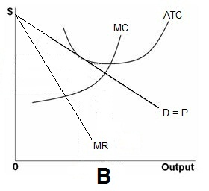
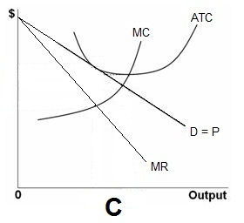
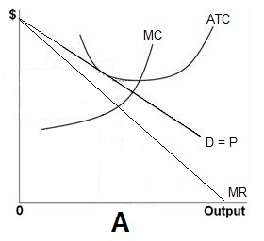
14. Which is correct?
A
B
C

Slide 64
14. Which is correct?
A
B
C

Slide 65
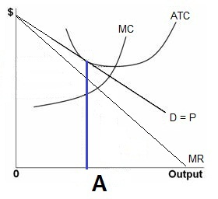
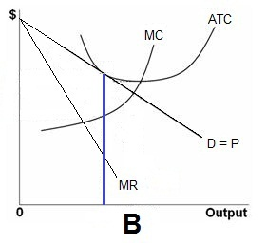
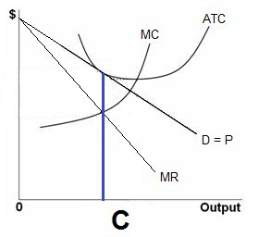
11a – Monopolistic Competition

Slide 66
YP 50

Slide 67
YP 50
15. What is the:
- profit max Q?
- prod. Eff. Q?
- alloc. Eff. Q?
Q1, Q2, Q3
Q1, Q3, Q2
Q2, Q3, Q1
Q3, Q2, Q1

Slide 68
YP 50
15. What is the:
- profit max Q?
- prod. Eff. Q?
- alloc. Eff. Q?
Q1, Q2, Q3
Q1, Q3, Q2
Q2, Q3, Q1
Q3, Q2, Q1

Slide 69
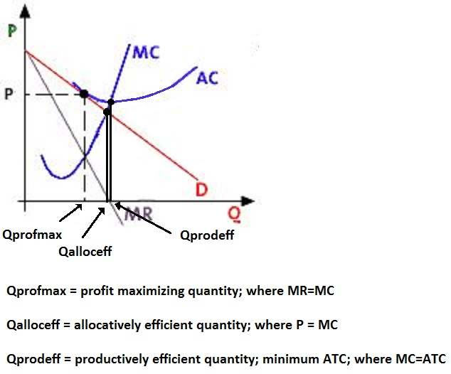

Slide 70
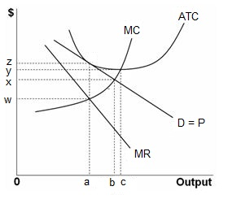
Allocative Inefficiency
At the profit maximizing quantity (0a):
P > MC
underallocation of resources
but close with elastic demand
also, some utility gained via product differentiation
only normal profits
11a – Monopolistic Competition

Slide 71
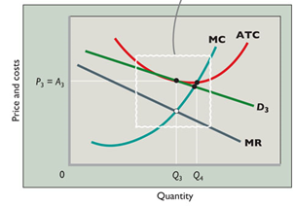
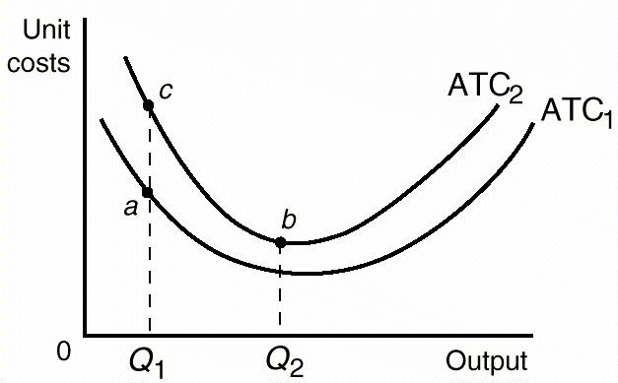
Productive Inefficiency
not minimum ATC (not where
MC=ATC)
- excess capacity
  Plant resources which are underused when imperfectly
  competitive firms produce less output than that associated with achieving minimum average total cost.
also, advertising may increase costs without increasing utility
(a to c)
BUT, advertising may lower costs if output expands (a to b)
11a – Monopolistic Competition

Slide 72
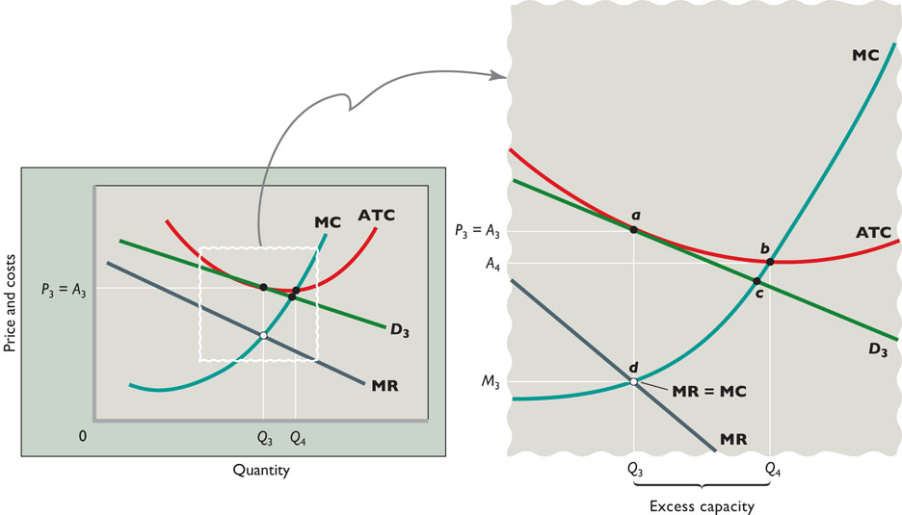
11a – Monopolistic Competition

Slide 73
16. We know that monopolistically competitive firms are allocatively inefficient, but why isn’t that so bad?
They earn long run profits
They donate to charities
There is no mutual interdependence
They produce a great variety

Slide 74
16. We know that monopolistically competitive firms are allocatively inefficient, but why isn’t that so bad?
They earn long run profits
They donate to charities
There is no mutual interdependence
They produce a great variety

