Slide 1
10b - ARE BUSINESSES EFFICIENT? Monopoly in the Long Run
This web quiz may appear as two pages on tablets and laptops.
I recommend that you view it as one page by clicking on the open book icon at the bottom of the page.

Slide 2
ARE BUSINESSES EFFICIENT? 10b – Monopoly: Long-Run Equilibrium
Long Run Equilibrium and Efficiency
Price Discrimination
Natural Monopolies and Regulation

Slide 3
10b -- Must Know/Outcomes:
Discuss the economic effects of pure monopoly on price, quantity of product produced, allocative and productive efficiency, distribution of income, and technological progress.
Understand the adjustment process from the short run to the long run and the role of barriers to entry
Why does a monopoly earn economic profits in the long run?
Draw the long run equilibrium graph for a pure monopoly and indicate the profit maximizing quantity, the allocatively efficient quantity, and the productively efficient quantity.
Define price discrimination, list three conditions necessary for price discrimination, explain how price discrimination affects allocative efficiency, explain why profits and output will be higher for a discriminating monopoly.
We know that single price monopolies are allocatively inefficient in the long run. What happens to allocative efficiency if the monopoly can price discriminate?
Identify two pricing strategies of monopoly regulation and explain the dilemma the regulators face in utilizing these strategies
Explain why a regulated monopoly does not have an incentive to reduce costs.
Why does the Illinois government allow ComEd to have a monoply on the distribution of electricity in northern Illinois?

Slide 4
10b -- Key Terms:
allocative inefficiency, productive inefficiency, deadweight loss, economies of scale, natural monopoly, X-inefficiency, dynamic efficiency, anti-trust policy, price fixing, tying contract, public interest theory of regulation, legal cartel theory of regulation, deregulation, price discrimination, regulated monopoly, natural, monopoly, socially-optimal price (alloc. efficient price), fair-return price (average-cost price)

Slide 5
Remember:
If there are no, or low, barriers to entry, then competing firms will earn normal (zero) economic profits (why?) and they will achieve allocative efficiency (or come close).
If there is blocked entry, or high barriers, then firms will earn economic profits (why?) and they will be allocatively inefficient.
10b – Monopoly: Long-Run Equilibrium

Slide 6
1. Monopolies can earn long run profits because:
They produce a unique product
They face a downward sloping demand
They are price makers (have market power)
They have barriers to entry

Slide 7
1. Monopolies can earn long run profits because:
They produce a unique product
They face a downward sloping demand
They are price makers (have market power)
They have barriers to entry

Slide 8
No or low barriers:
Pure Competition Monopolistic Competition
Blocked Entry or high barriers:
Monopoly Oligopoly
10b – Monopoly: Long-Run Equilibrium

Slide 9
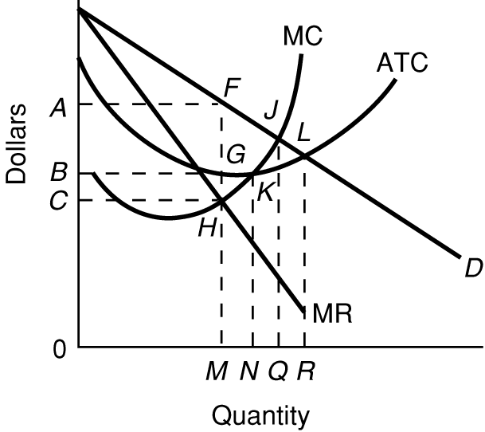
2. In the LR, what quantity will be produced? YP 35
M
N
Q
R

Slide 10
2. In the LR, what quantity will be produced? YP 35
M
N
Q
R

Slide 11
3. What is the Prod. Eff. Q? YP 35
M
N
Q
R

Slide 12
3. What is the Prod. Eff. Q? YP 35
M
N
Q
R

Slide 13
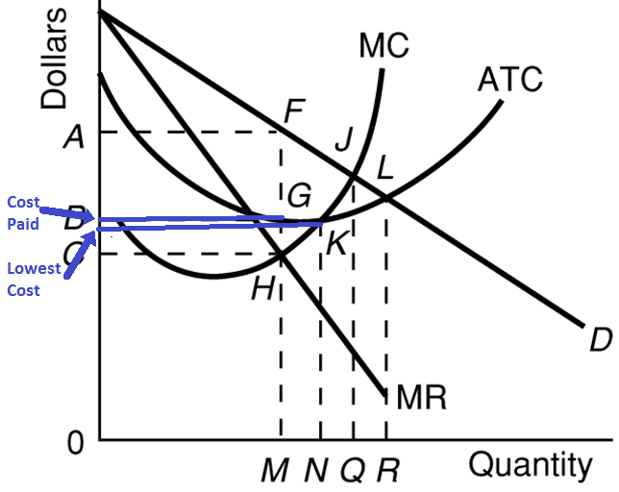
Monopoly: Productive Inefficiency

Slide 14
4. What is the Alloc. Eff. Q? YP 35
N
M
Q
R

Slide 15
4. What is the Alloc. Eff. Q? YP 35
N
M
Q
R

Slide 16
ARE MONOPOLIES EFFICIENT? NO!
The profit maximizing
Quantity is 0M, where
MR = MC (WHAT WE GET)
The allocatively efficient
quantity , 0Q, where
P=MC (WHAT WE WANT).
P>MC at 0M
Also monopolies do not produce at the lowest possible cost. They do not produce the productively efficient quantity where MC = ATC (0N).

Slide 17
Monopoly: LR Equilibrium
Dynamic Efficiency?
Means?
Incentive?
X-Inefficiency?
Possible?
Incentive?

Slide 18
Monopolies are Inefficient BUT, Cost Complications exist:
Economies of Scale make some monopolies MORE efficient:
Natural Monopolies [more efficient when regulated]
Simultaneous (nonrivalrous) Consumption [MORE efficient]
Network Effects [MORE efficient]
But other factors also affect the inefficiency of monopolies:
X-Inefficiency [even LESS efficient]
Rent-Seeking Behavior - protecting the monopoly [even LESS efficient]
Dynamic Inefficiency - Less Tech. Advances [even LESS efficient]
Price Discrimination [MORE efficient]
What can be done?
Antitrust Laws
Regulate Natural Monopolies
Creative Destruction

Slide 19
ARE BUSINESSES EFFICIENT?
10b – Monopoly: Long-Run Equilibrium
Long Run Equilibrium
Efficiency?
Price Discrimination
Natural Monopolies and Regulation

Slide 20
PRICE DISCRIMINATION
DEFINITION: The selling of a product to different buyers at different prices when the price differences are not justified by differences in cost.
EXAMPLES: Who pays more? / Who pays less?
ELECTRICITY: heating or lighting? homes or businesses?
DOCTORS: insured patients or uninsured?
3. AIR TRAVEL: business travelers or vacationers?
4. MOVIES / SKIING / GOLF: adults or children?
5. RAILROADS: expensive cargo or inexpensive cargo?
6. COUPONS
7. INTERNATIONAL TRADE
8. OTHERS ???? [cars, flea markets]
NECESSARY CONDITIONS:
Monopoly power ( price maker )
Market segregation: ability to segregate buyers according to their price elasticity of demand [Who pays more? Who pays less?]
3. No resale
CONSEQUENCES (graphically)
1. more profits 2. more production = more efficient

Slide 21
5. Which is NOT a necessary condition for price discrimination?
Market power
Prevent resale
Segregate buyers according to their price elasticities of demand
The product must be a normal good

Slide 22
5. Which is NOT a necessary condition for price discrimination?
Market power
Prevent resale
Segregate buyers according to their price elasticities of demand
The product must be a normal good

Slide 23
6. A price discriminating monopolist charges a higher price to customers who:
Have a more elastic demand
Have a less elastic demand
Have a perfectly elastic demand
Have a unit elastic demand

Slide 24
6. A price discriminating monopolist charges a higher price to customers who:
Have a more elastic demand
Have a less elastic demand
Have a perfectly elastic demand
Have a unit elastic demand

Slide 25
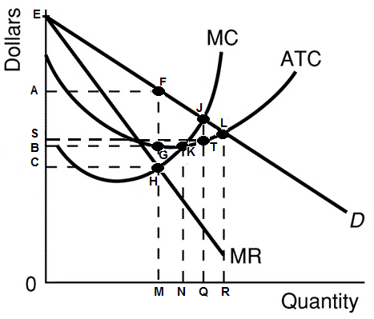
7.If this firm were a perfectly price discriminating monopolist, what quantity would be produced? YP 39
N
M
Q
R

Slide 26
7.If this firm were a perfectly price discriminating monopolist, what quantity would be produced? YP 39
N
M
Q
R

Slide 27
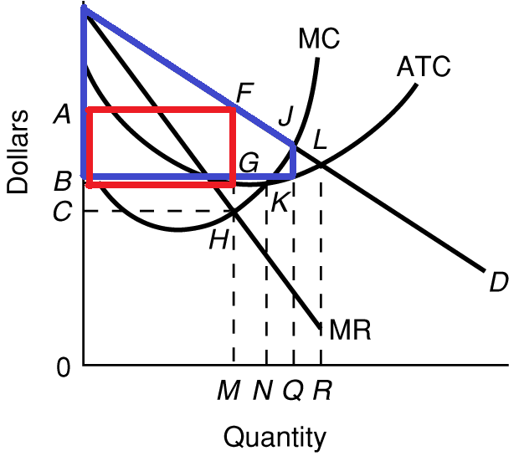
PRICE DISCRIM.
Profits
Quantity: Q
SINGLE PRICE
Profits
Quantity: M
ALLOC. EFF.
Quantity: Q
Note: price
Discrimination
may be eff.
For a perfectly price discriminating monopolist
the price (D) is the MR.
YP 39

Slide 28
ARE BUSINESSES EFFICIENT?
10b – Monopoly: Long-Run Equilibrium
Long Run Equilibrium
Efficiency?
Price Discrimination
Natural Monopolies and Regulation

Slide 29
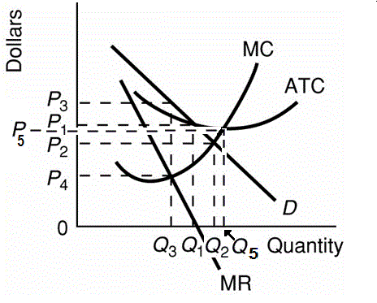
Regulated Monopoly
Why rate regulation instead of antitrust?
Definitions:
Antitrust
Laws that prohibit anticompetitive business practices such as price fixing, bid rigging, monopolization, and tying contracts.
Natural Monopoly
An industry in which economies of scale are so great the product can be produced by one firm at a lower average total cost than if the product were produced by more than one firm.
Graph of a Natural Monopoly:
Demand crosses ATC while ATC is still downward sloping
[See Lecture Outline]

Slide 30
Regulated Monopoly
Why government gets involved:
to improve allocative efficiency: "public interest "
The presumption that the purpose of the regulation of an industry is to protect the public (consumers) from abuse of the power possessed by natural monopolies.
2. political reasons: legal cartel theory
The hypothesis that some industries seek regulation or want to maintain regulation so they may form or maintain a legal cartel.
a. Proponents of this theory contend that regulators guarantee a return to the regulated firms while blocking entry and dividing up the market - activities that would be illegal in unregulated markets.
b. Occupational licensing is an example of this theory in certain labor markets.
10b – Monopoly: Long-Run Equilibrium

Slide 31
Regulated Monopoly
How the government can regulate rates (prices):
P = MC: socially optimum price (P2) (allocatively efficient price)
a. Achieve allocative efficiency The price of a product which results in the most efficient allocation of an economy's resources and is equal to the marginal cost of the product. (ALLOCATIVE EFFICIENCY)
b. Graph: P2 and Q2
c. Results in a LOSS for the firm. In the long run companies will go out of business.
d) Government could subsidize or use AC pricing
2. P = ATC: "fair" return price (P1)
a. Definition The price of a product which enables its producer to obtain a normal profit and which is equal to the average total cost of producing it.
b. Graph: P1 and Q1
c. Still some inefficiency
d. But normal profits (no losses)
If not regulated this monopoly would charge
a price of P3 and produce Q3. This is both allocatively and productively inefficient.
10b – Monopoly: Long-Run Equilibrium

Slide 32
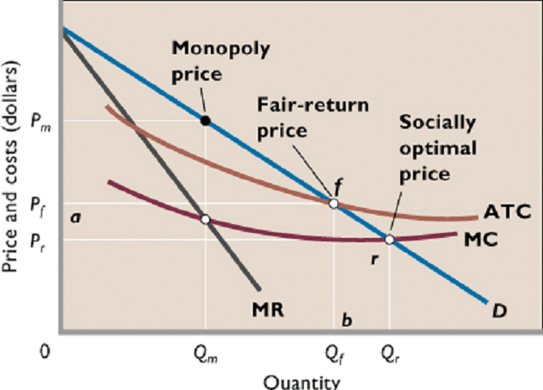
Regulated Monopoly

Slide 33
8. How can you tell that this is a natural monopoly? YP 37
D is greater than MR
MR = zero at Q1
Demand crosses ATC when ATC is downward sloping
MC crosses ATC at the lowest point of the ATC

Slide 34
8. How can you tell that this is a natural monopoly? YP 37
D is greater than MR
MR = zero at Q1
Demand crosses ATC when ATC is downward sloping
MC crosses ATC at the lowest point of the ATC

Slide 35
9. If this monopoly was not regulated they would charge a price of: (YP 37)
P1
P2
P3
P4

Slide 36
9. If this monopoly was not regulated they would charge a price of: (YP 37)
P1
P2
P3
P4

Slide 37
10. If this monopoly was not regulated they would produce ____ and the alloc. Eff Q is ___: (YP 37)
Q3, Q1
Q3, Q2
Q1, Q3
Q1, Q2
Q2, Q2

Slide 38
10. If this monopoly was not regulated they would produce ____ and the alloc. Eff Q is ___: (YP 37)
Q3, Q1
Q3, Q2
Q1, Q3
Q1, Q2
Q2, Q2

Slide 39
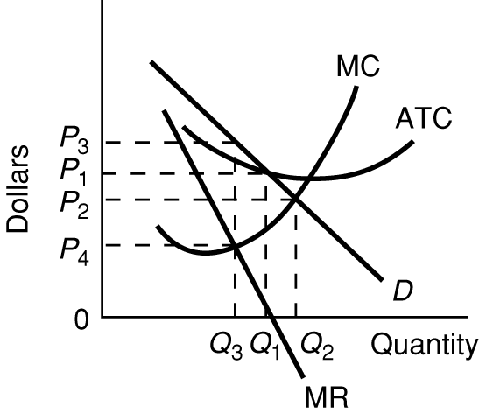
11. If the government wanted to achieve alloc. eff. they would put a price ceiling at: (YP 37)
P1
P2
P3
P4

Slide 40
11. If the government wanted to achieve alloc. eff. they would put a price ceiling at: (YP 37)
P1
P2
P3
P4
What is a problem with setting the price to achieve allocative efficiency?

Slide 41
12. If the government uses AC pricing (fair return pricing) they would put a price ceiling at: (YP 37)
P1
P2
P3
P4

Slide 42
12. If the government uses AC pricing (fair return pricing) they would put a price ceiling at: (YP 37)
P1
P2
P3
P4
Will this price achieve allocative efficiency?

Slide 43
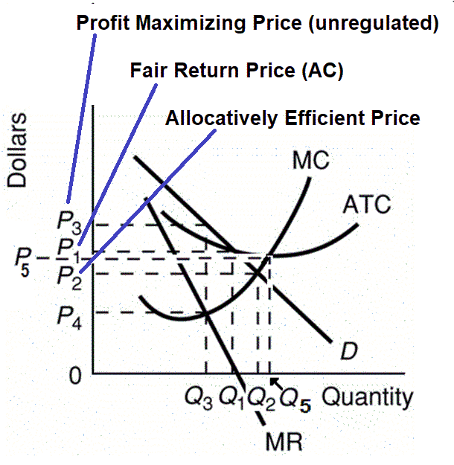
Monopoly: Rate Regulation

Slide 44
Monopoly: Rate regulation

