Slide 1
ARE BUSINESSES EFFICIENT? 10a - Monopoly
This web quiz may appear as two pages on tablets and laptops.
I recommend that you view it as one page by clicking on the open book icon at the bottom of the page.

Slide 2
Review Lesson 8/9b Pure Competition in the Long Run
YP 19 Draw the Long Run Equilibrium Graph for Pure Competition and Identify :
The Profit Maximizing Quantity
The Allocatively Efficient Quantity
The Productively Efficient Quantity
10a – Monopoly in the Short Run

Slide 3
ARE BUSINESSES EFFICIENT?
10a – Monopoly in the Short Run
Monopoly
Characteristics and Examples
Barriers to Entry
Short Run Equilibrium
Profit maximizing case
Loss minimizing case
Shut down case

Slide 4
For “Monopolies” Know:
10a – Monopoly in the Short Run
1. Characteristics and Examples 2. Nature of the Demand Curve 3. Short Run Equilibrium 4. Long Run Equilibrium and Efficiency 5. Other Issues
Barriers to Entry
Price Discrimination
Regulated Monopolies
See YP 24 for outline of lesson 10a (monopolies).

Slide 5
10a Must Know / Outcomes:
List the five characteristics of pure monopoly.
List and give examples of the four barriers to entry.
Describe the demand curve facing a pure monopoly and how it differs from that facing a firm in a purely competitive market.
Why is the demand curve for a monopoly downward sloping?
Compute marginal revenue when given a monopoly demand schedule.
Explain why the marginal revenue is equal to the price in pure competition but marginal revenue is less than price in monopoly.
- Why is the MR curve below the demand curve?
- Why is the extra revenue that a monopoly receives from selling one more unit (MR) less than the price that they charge for that unit (D)?
Determine the price and output level the monopoly will choose given demand and cost information in both table and graphic form.
Draw the short run equilibrium graphs for a pure monopoly that (a) maximizes profit, (b) minimizes loss, and (c) shuts down.

Slide 6
KEY TERMS:
pure monopoly,
price maker,
barriers to entry,
economies of scale,
patent,
natural monopoly
10a – Monopoly in the Short Run

Slide 7
LESSON 10a INTRODUCTION (1)
ARE BUSINESSES EFFICIENT?
We learned in lessons 2a, and 8/9a and b, that competitive markets are efficient (except when there are externalities or public goods). But what happens if markets are NOT competitive? We said that competition is the "invisible hand" that forces businesses to be efficient. If the market is not competitive we will not get the efficient quantity. This means that the profit maximizing quantity that businesses will produce (WHAT WE GET; quantity where MR=MC) will not be the same as the allocatively efficient quantity that society wants (WHAT WE WANT; quantity where P=MC).
10a – Monopoly in the Short Run

Slide 8
LESSON 10a INTRO. (2) - ARE BUSINESSES EFFICIENT?
Remember the word "competition" has a different meaning in economics. This is NOT the competition that occurs between Ford and Chevrolet. "Competition" in economics means there are many buyers and sellers in the market so that firms have no influence over the price; i.e. they are price takers. Much of the business world is not competitive, and therefore, not efficient.
In this lesson we will look at monopolistic industries - industries with only one firm. There are few pure monopolies. Even though there are few true monopolies they do exist, but we will also study monopolies because most firms are a combination of competition and monopoly.
10a – Monopoly in the Short Run

Slide 9
10a Something Interesting - Why are we studying this?
What's so bad about monopoly power? http://www.cbsnews.com/news/whats-so-bad-about-monopoly-power/ (9/19/14)
“Google (GOOG) has been negotiating with European regulatory authorities since 2010 in an attempt to settle an antitrust case concerning its search engine, and its third attempt to settle the case has been rejected.
Google may also face new antitrust problems over its Android mobile operating system, and it's not alone in facing tough antitrust scrutiny in Europe. Microsoft (MSFT) has also been the subject of a long-running battle in Europe over market dominance issues.
But what's motivating this scrutiny from European regulators? What's so bad about a company amassing monopoly power?”
ANSWER: "The bottom line is that when companies have a monopoly, prices are too high and production is too low. There's an inefficient allocation of resources."
10a – Monopoly in the Short Run

Slide 10
ARE BUSINESSES EFFICIENT?
10a – Monopoly in the Short Run
Monopoly
Characteristics and Examples
Barriers to Entry
Short Run Equilibrium
Profit maximizing case
Loss minimizing case
Shut down case

Slide 11
1. Which is NOT a characteristic of monopolies? YP2
Single firm
A lot of control over price
Mutual interdependence
Unique product
Blocked entry
Public relations non-price competition

Slide 12
1. Which is NOT a characteristic of monopolies? YP2
Single firm
A lot of control over price
Mutual interdependence
Unique product
Blocked entry
Public relations non-price competition

Slide 13
2. Which of the following is a good example of a monopoly?
A fast-food restaurant
A soft drink company
A local electric company
A construction firm

Slide 14
2. Which of the following is a good example of a monopoly?
A fast-food restaurant
A soft drink company
A local electric company
A construction firm

Slide 15
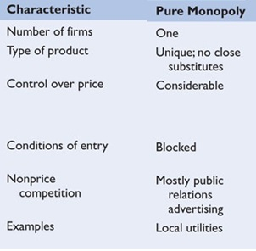

Slide 16
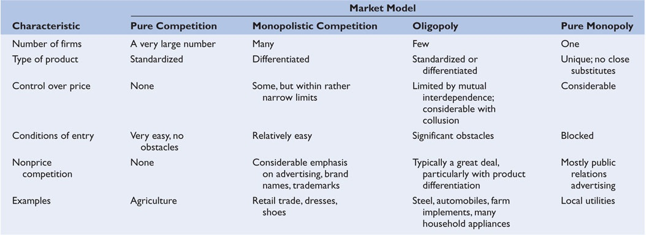

Slide 17
Examples of Monopolies
(from the textbook)
LEGAL MONOPOLIES: Public utilities: gas, electric, water, cable TV, and local telephone service companies, are often pure monopolies.
NEAR MONOPOLIES: Central Microprocessors (Intel 80% of market), First Data Resources (Western Union 80% of money order transfers), Wham-o (Frisbees 90% of market), Brannock Device Company (shoe sizing devices 80% or market), and Google (70% of internet searches; 75% of internet ad revenue)
Manufacturing monopolies are virtually nonexistent in nationwide U.S. manufacturing industries.
Professional sports leagues grant team monopolies to cities.
Monopolies may be geographic. A small town may have only one airline, bank, etc.

Slide 18
Why Study Monopolies?
because they really do exist
because most industries are a combination of pure competition and pure monopoly
monopolistic competition
oligopoly
10a – Monopoly in the Short Run

Slide 19
ARE BUSINESSES EFFICIENT?
10a – Monopoly in the Short Run
Monopoly
Characteristics and Examples
Barriers to Entry
Short Run Equilibrium
Profit maximizing case
Loss minimizing case
Shut down case

Slide 20
3. Which of the following is NOT a barrier to entry?
Economies of scale / costs
Legal barriers
Ownership of essential raw material
Pricing and other strategies
Price discrimination

Slide 21
3. Which of the following is NOT a barrier to entry?
Economies of scale / costs
Legal barriers
Ownership of essential raw material
Pricing and other strategies
Price discrimination

Slide 22
Barriers to Entry
1. Economies of Scale (see next screen)
2. Legal Barriers
Patents
licenses
3. Ownership or control of essential raw materials
4. Pricing and other Strategic Barriers
10a – Monopoly in the Short Run

Slide 23
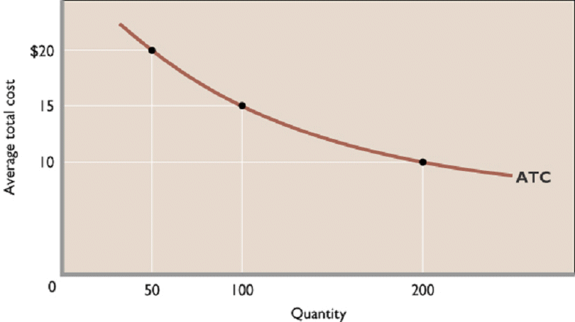
Economies of Scale / Cost Barrier / Natural Monopoly
10a – Monopoly in the Short Run

Slide 24
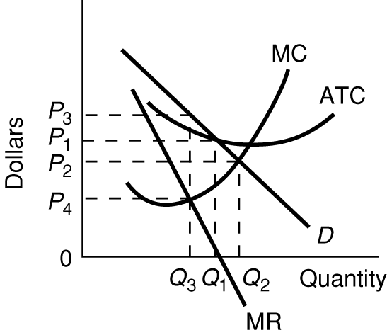
Natural Monopoly
Large economies of scale therefore
D crosses ATC when ATC is downward sloping.
Indicates one firm can provide all that is demanded at a lower cost than if there were several firms,
i.e. it is “natural” to have one firm in the industry.

Slide 25
4. Why are barriers important?
They determine long run profits
They allow for price discrimination
They permit product differentiation
They create mutual interdependence

Slide 26
4. Why are barriers important?
They determine long run profits
They allow for price discrimination
They permit product differentiation
They create mutual interdependence

Slide 27
Why are Barriers Important?
Barriers to entry allow firms to earn long run profits and to be inefficient.
Pure Comp. = no barriers = no long run profits
Monopoly = entry blocked = long run profits
Monop. Comp. = few barriers = no long run profits
Oligopoly = high barriers = long run profits
10a – Monopoly in the Short Run

Slide 28
For “Monopolies” Know:
10a – Monopoly in the Short Run
1. Characteristics and Examples 2. Nature of the Demand Curve 3. Short Run Equilibrium 4. Long Run Equilibrium and Efficiency 5. Other Issues
Barriers to Entry
Price Discrimination
Regulated Monopolies
YP 24 Outline of what we will study about monopolies

Slide 29
5. The demand curve facing a monopoly is:
Perfectly elastic
Relatively elastic
Equal to its MR
Downward sloping

Slide 30
5. The demand curve facing a monopoly is:
Perfectly elastic
Relatively elastic
Equal to its MR
Downward sloping
See YP 25 - Graph D (price).

Slide 31
Marginal = Change in Total / Change in Q
MU = Change in TU / Change in Q consumed (6a)
MP = Change in TP / Change in Q of resources (7a)
MC = Change in TC / Change in Q produced (7b)
MR = Change in TR / Change in Q sold (lessons 8-11)
MRP = Change in TR / Change in Q of resources (12-13)
MRC = Change in TC / Change in Q of resources (12-13)
10a – Monopoly in the Short Run

Slide 32
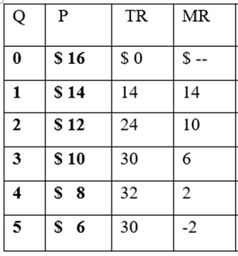
See YP 25 - Calculate MR. Plot D and MR.
10a – Monopoly in the Short Run

Slide 33
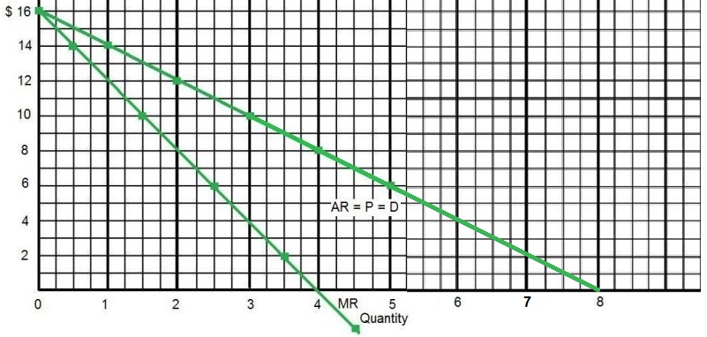
See YP 25 - Calculate MR. Plot D and MR.
10a – Monopoly in the Short Run

Slide 34
6. A monopolist can sell 1 widget for $5. In order to sell 2 widgets, the firm must lower the price to $4. What is the MR of the second widget?
MR = $1
MR = $2
MR = $3
MR = $4
MR = $5

Slide 35
6. A monopolist can sell 1 widget for $5. In order to sell 2 widgets, the firm must lower the price to $4. What is the MR of the second widget?
MR = $1
MR = $2
MR = $3
MR = $4
MR = $5

Slide 36
7. The MR is less than the price for imperfectly competitive firms because:
Demand is elastic
To sell more they must lower the price of all that they sell
Entry is blocked
They sell unique products

Slide 37
7. The MR is less than the price for imperfectly competitive firms because:
Demand is elastic
To sell more they must lower the price of all that they sell
Entry is blocked
They sell unique products

Slide 38
10a – Monopoly in the Short Run

Slide 39
8. Which is drawn correctly?
A
B
C

Slide 40
8. Which is drawn correctly?
A
B
C

Slide 41
To accurately draw D and MR, imagine where MR will
intersect the horizontal axis (8). Then, the MR curve will cross
the horizontal axis halfway between the origin (0) and MR.
10a – Monopoly in the Short Run

Slide 42
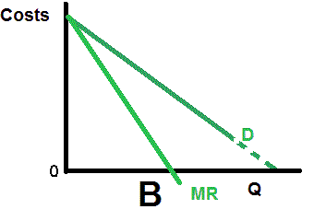
10a – Monopoly in the Short run

Slide 43
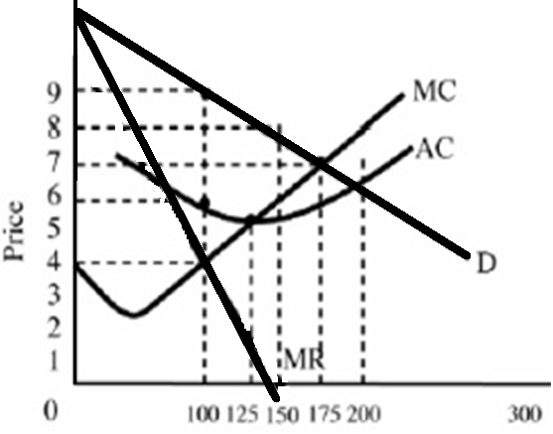
What is wrong this graph?

Slide 44
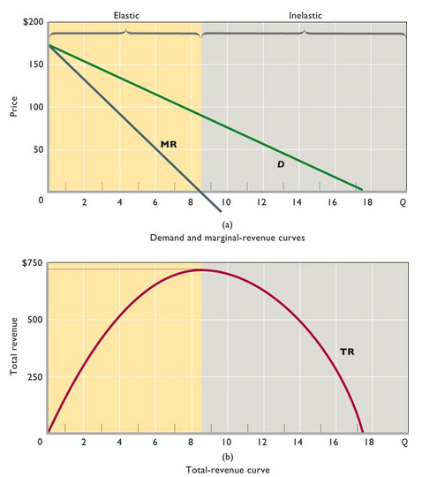
MONOPOLY DEMAND:
Monopoly demand is the market demand
Demand is downsloping
P>MR
Price maker
Price will be set in the elastic part of the demand curve where MR is positive
Remember: MR is the slope of TR

Slide 45
10a – Monopoly in the Short Run
MARGINALS – Review a few concepts:
Marginal = change in total / change in quantity
Marginal = slope of total
Total = sum of the marginals
Total = area under the marginal graph

Slide 46
Marginal = Change in Total / Change in Q
MU = Change in TU / Change in Q consumed (6a)
MP = Change in TP / Change in Q of resources (7a)
MC = Change in TC / Change in Q produced (7b)
MR = Change in TR / Change in Q sold (lessons 8-11)
MRP = Change in TR / Change in Q of resources (12-13)
MRC = Change in TC / Change in Q of resources (12-13)
10a – Monopoly in the Short Run

Slide 47
YP 25, 26, 27 -- Find the profit maximizing price, quantity, and the maximum possible profits on a table and graph (WHAT WE GET).
Monopoly
Characteristics and Examples
Barriers to Entry
Short Run Equilibrium
Profit maximizing case
Loss minimizing case
Shut down case
10a – Monopoly in the Short Run

Slide 48
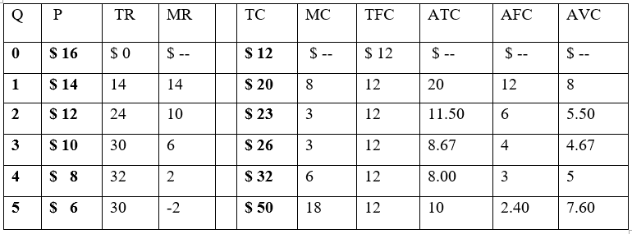
YP 25, 26, 27
Monopoly: Short Run Equilibrium
Find the profit max. P, Q, and profits
10a – Monopoly in the Short Run

Slide 49
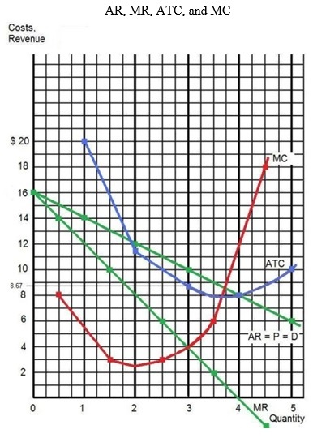
YP 25, 26, 27
Monopoly: Short Run Equilibrium
Find the profit max. P, Q, and profits
10a – Monopoly in the Short Run

Slide 50
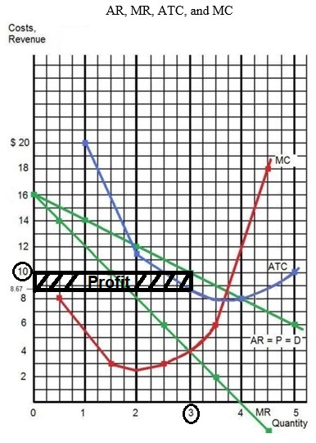
YP 25, 26, 27
Monopoly: Short Run Equilibrium
Find the profit max. P, Q, and profits
10a – Monopoly in the Short Run

Slide 51
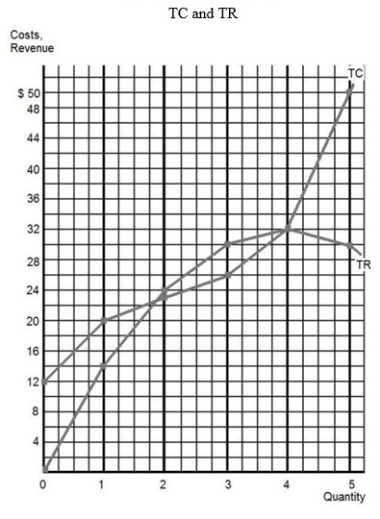
YP 25, 26, 27
Monopoly: Short Run Equilibrium
Find the profit max. P, Q, and profits
10a – Monopoly in the Short Run

Slide 52
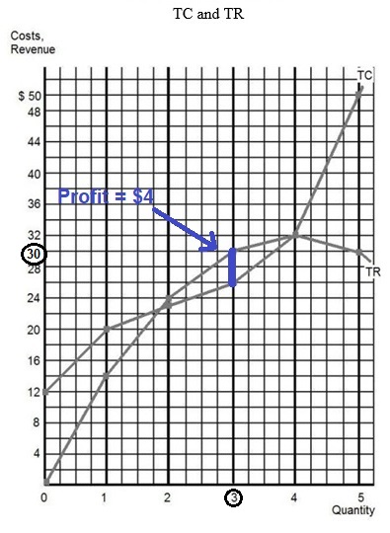
YP 25, 26, 27
Monopoly: Short Run Equilibrium
Find the profit max. P, Q, and profits
10a – Monopoly in the Short Run

Slide 53
9. What Q would this monopoly produce? YP36
100
125
150
175
200

Slide 54
9. What Q would this monopoly produce? YP31
100
125
150
175
200

Slide 55
10. What price would be charged? YP 31
$4
$6
$7
$8
$9

Slide 56
10. What price would be charged? YP 31
$4
$6
$7
$8
$9

Slide 57
11. What would the profits be? YP 31
$1200
$900
$600
$400
$300

Slide 58
11. What would the profits be? YP 31
$1200
$900
$600
$400
$300

Slide 59
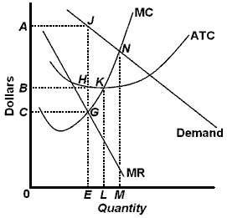
MONOPOLY
(YP 33 # 11,
12, 13, 14)
Q= ?
P = ?
TR = ?
ATC = ?
TC = ?
Profits = ?

Slide 60
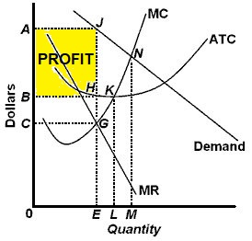
MONOPOLY
(YP 33 # 11,
12, 13, 14)
Q= 0E
P = 0A
TR = 0AJE
ATC = 0B
TC = OBHE
Profits = BAJH

Slide 61
Find the profit maximizing price, quantity, and the maximum possible profits on a table , graph and a graph with letters (using geometry).
Monopoly
Characteristics and Examples
Barriers to Entry
Short Run Equilibrium
Profit maximizing case
Loss minimizing case
Shut down case
10a – Monopoly in the Short Run

Slide 62
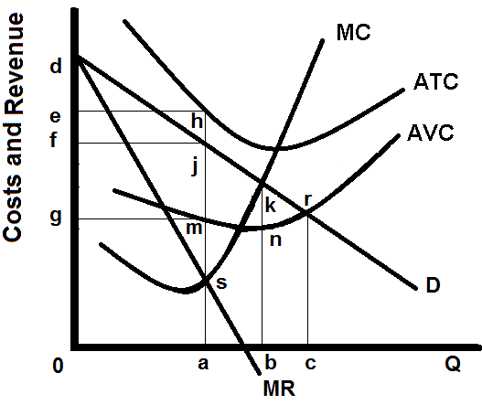
MONOPOLY
(YP 33 # 15)
Q = ?
P = ?
TR = ?
ATC = ?
TC = ?
Profits = ?

Slide 63
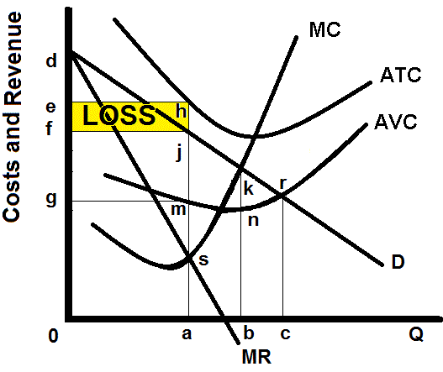
MONOPOLY
(YP 33 # 15)
Q = 0q
P = 0f
TR = 0fja
ATC = 0e
TC = 0eha
Loss = fehj

Slide 64
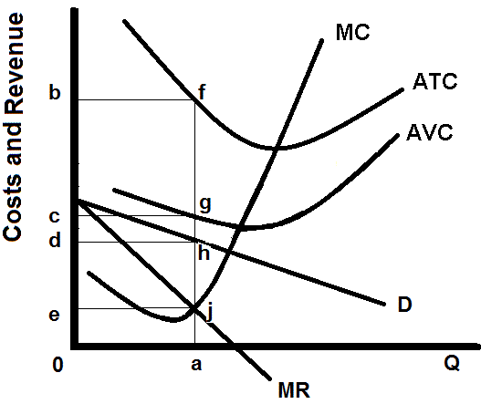
MONOPOLY
(YP 33 # 16)
Q= ?
P = ?
TR = ?
ATC = ?
TC = ?
Profits = ?

Slide 65
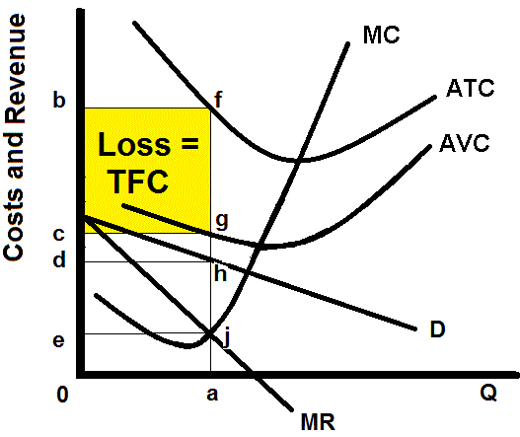
MONOPOLY
(YP 33 # 16)
Q = 0a
P = 0d
TR = 0
ATC = cb
TC = TFC
Loss = cbfg
Since P is less than AVC the firm will shut down, produce zero, and the loss will be the TFC = cbfg

Slide 66
How to find the profit maximizing quantity:
A firm will maximize its profit (or minimize its losses) by producing that output at which marginal revenue and marginal cost are equal provided product price is equal to or greater than average variable cost.
(1) Find the quantity where: MR = MC (as long as MC is upward sloping)
(2) produce this quantity only if: P > AVC or AR > AVC
This is WHAT WE GET

Slide 67
From YP 34

Slide 68
Be able to draw the short run graphs of a monopoly earning profits, losses, and shutting down.
Profits Losses Shut Down

Slide 69
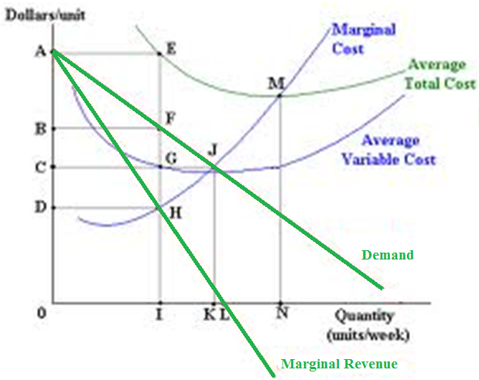
12. What are the profits or losses?
0AEI
0BFI
BAEF
CBFG

Slide 70
12. What are the profits or losses?
0AEI
0BFI
BAEF
CBFG

Slide 71
FOR MONOPLIES BE ABLE TO:
Find Short Run Price, Quantity, and Profits/Losses Three ways:
Table of data (YP 25 and 31)
Graph with numbers (YP 29-30, 31)
Graph with letters (YP 33)
Draw the Graph showing Short Run Price, Quantity, and Profits/Losses for firms:
earning profits, (YP 28 and 33 #11)
earning losses, (YP 28 and 33 #15)
and shutting down (YP 28 and 33 #16)
DO THE YELLOW PAGES AND ASK QUESTIONS!

